Slide 1
AI 620 EMERGING TOPICS IN ARTIFICIAL INTELLIGENCE
Module 6
Amazon SageMaker and Machine Learning Inference Pipelines

Slide 2
Learning outcomes
Spark EMR
Amazon SageMaker
Hyperparameter optimization
Amazon Glue and SparkML
NTM in SageMaker

Slide 3
Preprocessing big data through Spark EMR
EMR (Elastic MapReduce) clusters are to conduct distributed data processing.
Hadoop is used as underlying distributed filesystem while Spark will be used as the distributed computing framework.
AWS EMR notebooks provide a managed notebook environment, based on Jupyter Notebook.
One of the critical components of Amazon EMR architecture is the Livy service. It is an open source REST interface for interacting with Spark clusters without the need for Spark client.

Slide 4
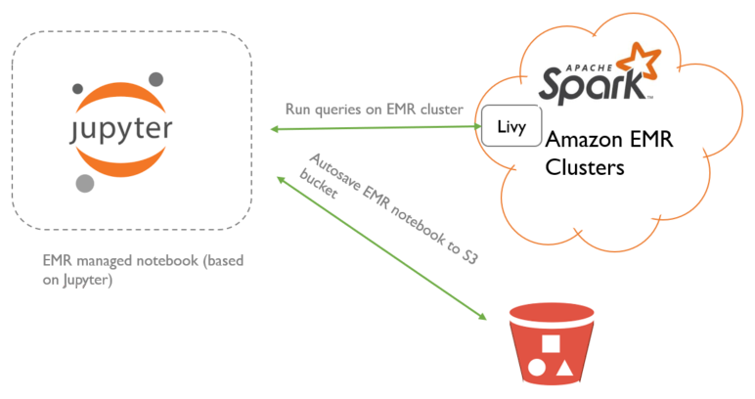
EMR notebooks communicate with Spark EMR clusters

Slide 5
In the EMR notebook, we do five things
Read the ratings and books CSV files.
Analyze the ratings dataset to understand the number of ratings by user and book.
Filter the original ratings dataset to only include ratings, where it contains users who have rated more than 1% of books and books that have been rated by at least 2% of the users.
Create indexes (starting with zero) for both users and books in the ratings dataset—this is required to train the object2vec algorithm.
Write (in parquet format) the resulting ratings dataset, which also includes the book title, to relevant S3 bucket. The ratings dataset will then have a rich history of user preferences, along with the popularity of books.

Slide 6
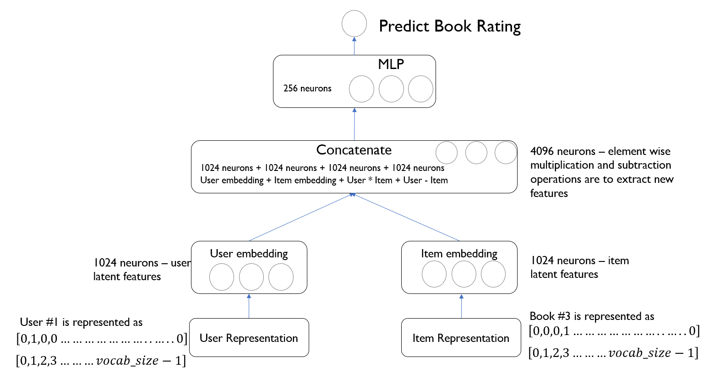
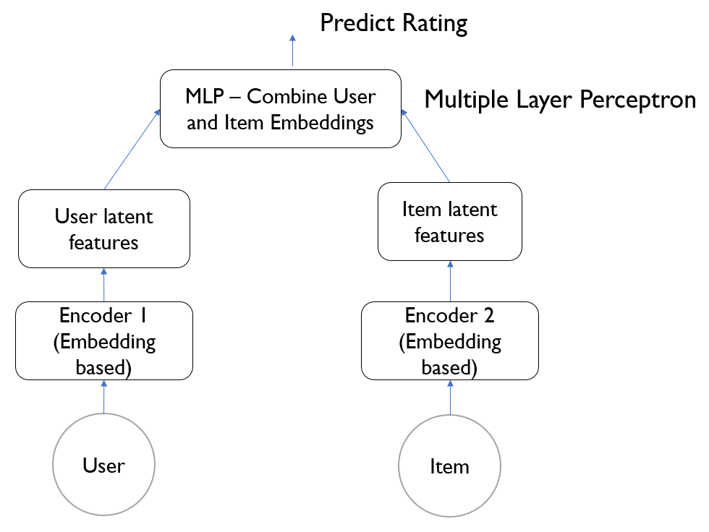
Learn how object2vec works

Slide 7
Train the object2vec algorithm
Data processing: Feed data in the form of JSON lines; random shuffle the data for optimal performance. As you will see later, we send data in the format of user index, book index, label=rating.
Model training: We pass both training and validation data to the algorithm. There are multiple hyperparameters that we can configure to fine-tune the model's performance. We will review them in the upcoming sections. The objective function, in our case, is to minimize the Mean Squared Error (MSE). The error is the difference between the label (actual value) and the predicted rating.

Slide 8
hyperparameters
Encoder network
Enc0_layers, enc0_max_seq_len, enc0_network, enc0_vocab_size
MLP
Mlp_dim, mlp_layers, mlp_activation
Model control
Epochs, mini_batch_size, early_stopping_patience, early_stopping_tolerance
Others
Optimizer, output_layer

Slide 9
Deploy the trained object2vec and running inference
First, we will create a model from the training job using the create_model() method of the SageMaker Estimator object.
Once the model has been created, it can be deployed as an endpoint via the deploy() method of the SageMaker Model object.
Once the object2vec model has been deployed as an endpoint, we can navigate to the Endpoints section under the Inference grouping (present on the left navigation menu under the SageMaker service).
We will create the RealTimePredictor object (the SageMaker Python SDK) by passing the endpoint name, along with the type of serialization and deserialization for the input and output, respectively.
We then invoke the predict() method of RealTimePredictor.

Slide 10
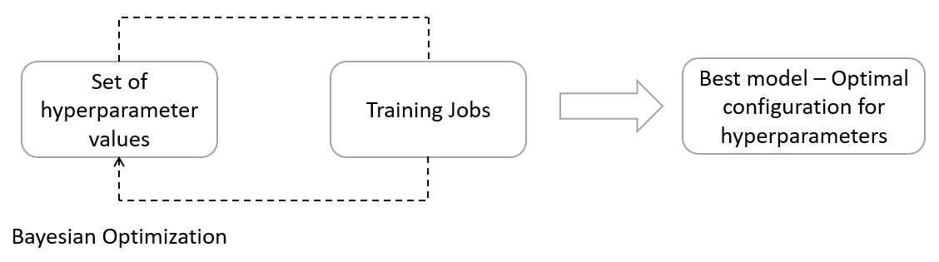
Hyperparameter optimization (HPO)
Hyperparameter Optimization (HPO), from SageMaker, automates the process of selecting the optimal combination of hyperparameters. Here is how the tool works:

Slide 11
HPO details
HPO uses a Bayesian technique to iteratively select a combination of hyperparameters to train the algorithm.
HPO picks the next set of hyperparameters, given the performance of the model and the configuration of hyperparameters in all of the historical steps.
Also, it employs an acquisition function to determine where the next best opportunity is to lower the cost function.
After a specified number of iterations, you will arrive at an optimal configuration of hyperparameters producing the best model.

Slide 12
Bring your own model/container
SageMaker allows you to bring your own deep learning libraries to the Amazon Cloud and still utilize the productivity features of SageMaker to automate training and deployment at scale.
It also allows bringing your own Docker container to Amazon SageMaker.

Slide 13
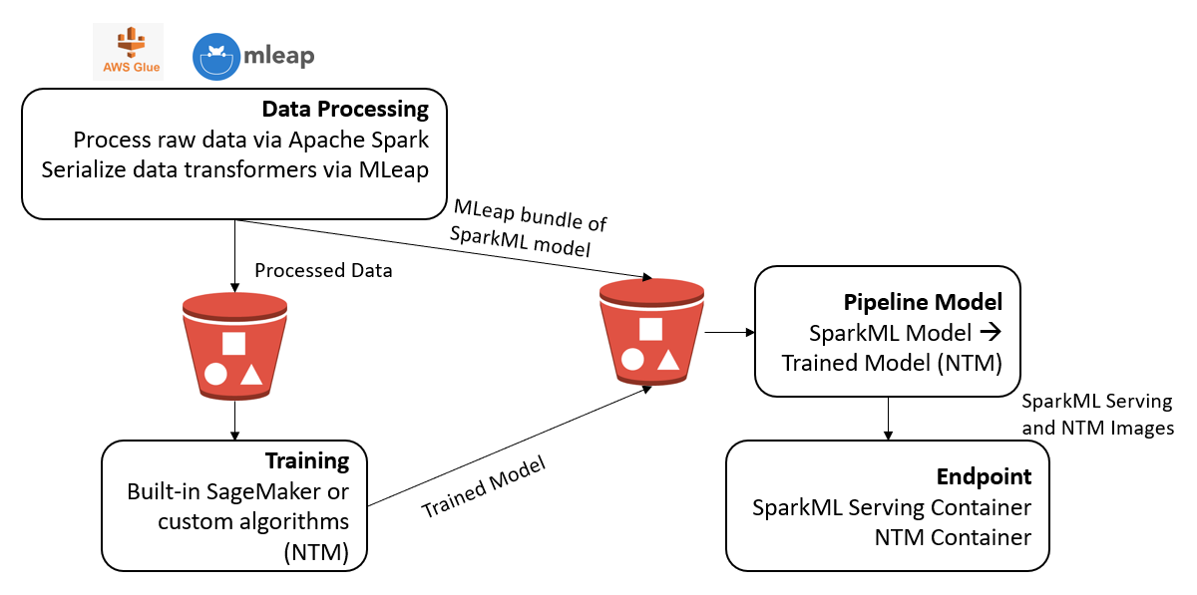
Architecture of the inference pipeline in sagemaker

Slide 14
Amazon glue and mleap
Amazon Glue is a fully managed, serverless Extract, Transform, and Load (ETL) service that's used to wrangle big data. ETL jobs are run on an Apache Spark environment where Glue provisions, the configuration and scale the resources that are required to run the jobs.
MLeap is an open source Spark package that's designed to serialize Spark-trained transformers. Serialized models are used to transform data into the desired format.

Slide 15
PE06 Implementations
PE06-1 The prerequisites
Textbook 286 step 1 to 4
PE06-2 Preprocessing data using PySpark
2.1 Gather arguments sent by the SageMaker Notebook instance
2.2 Read the news headlines
2.3 Retrieve 10% of the headlines and define the data transformations
2.4 Stitch all the transformer and estimator stages together into a pipeline and transform the headlines into feature vectors
2.5 Save the resulting feature vectors in .csv format
2.6 Similarly, we will also save the vocabulary into a separate text file
2.7 Serialize news_pl_fit and push it to an S3 bucket

Slide 16
PE06 IMPLEMENTATIONS
PE 06-3 Create an AWS Glue job
PE 06-4 Train NTM in SageMaker
Follow textbook 292 step 1 to 5
PE 06-5 Prediction
5.1 Create real-time predictions through inference pipeline
5.2 Create batch predictions through inference pipeline
DONE!

Slide 17
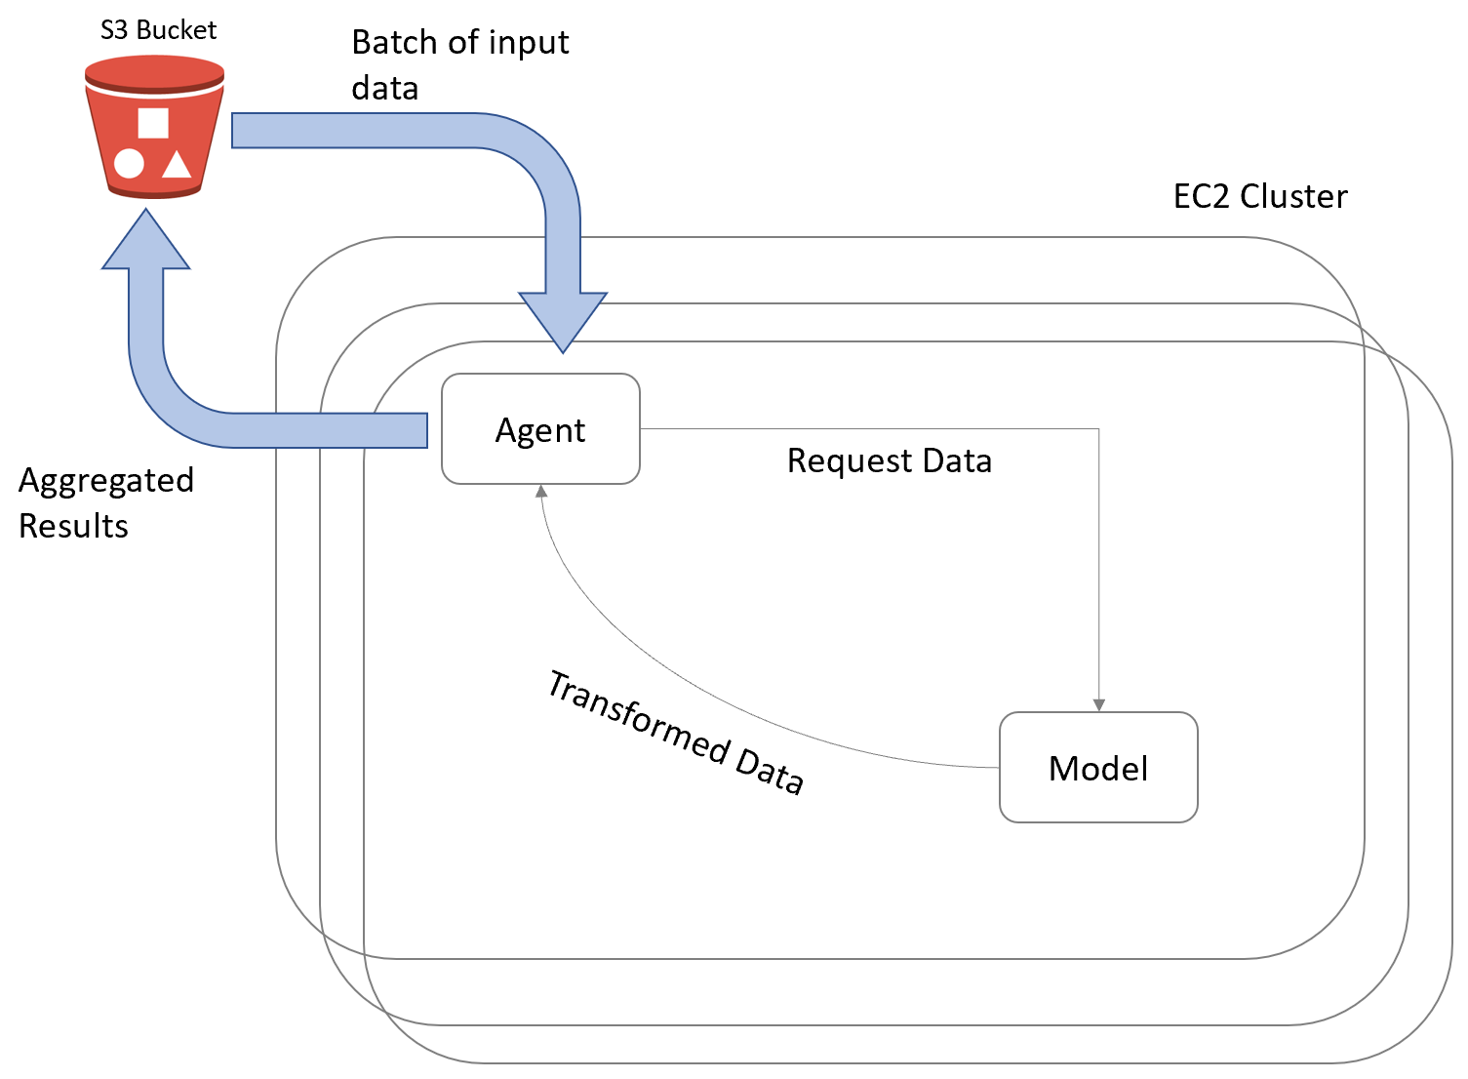
Batch transform

Slide 18
References
Tripuraneni, S., & Song, C. (2019). Hands-On Artificial Intelligence on Amazon Web Services. Packt Publishing. https://learning.oreilly.com/library/view/hands-on-artificial-intelligence/9781789534146/

